Slide 1

DEVELOPMENT OF SMART HEALTH CARE SYSTEM
Md. Mobinul Islam
Md. Nimuzzaman
Asif Bin Nur
Dr. Md. Ashraful Islam
Dr. Md. Matiqul Islam
Dept. of ICE, University of Rajshahi
National Conference on Physics-2023/ EICT-02 (Jahangirnagar University, Bangladesh / March. 10,2023)

Slide 2
Outline
Introduction
Goals and Visions
User Base
Patient
Doctor
Receptionist
Laboratory Personnel
Administrator
Collaboration & Coordination
Conclusions

Slide 3
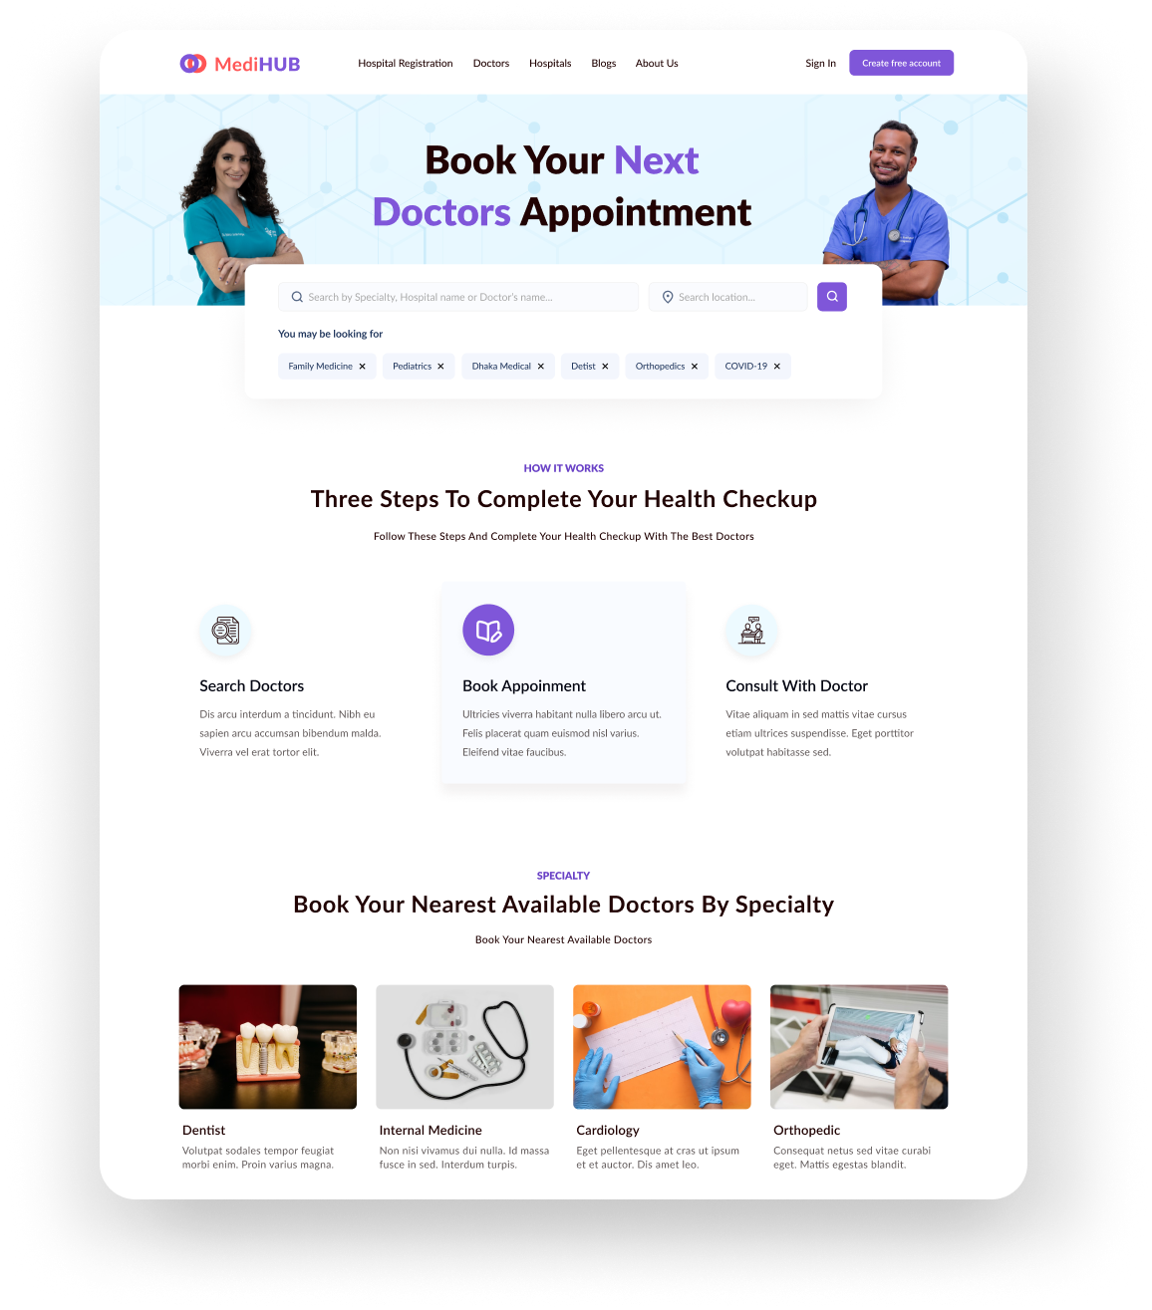
INTRODUCTION
The medical ecosystem is a comprehensive solution for the healthcare industry, connecting various stakeholders including labs, doctors, receptionists, and administration.
The system aims to provide a seamless and efficient approach to managing all aspects of healthcare delivery.
In this presentation, we will introduce the key players in the medical ecosystem and their roles, discuss the challenges and opportunities in healthcare delivery, and highlight the goals and vision of this project.
We believe that this application has the potential to transform healthcare delivery and contribute to the overall well-being of individuals and communities.

Slide 4
Goals & Visions
Provide a comprehensive, user-friendly, and integrated platform for patients, healthcare professionals, and administrators to improve healthcare outcomes, increase efficiency, and reduce costs.
The platform will leverage advanced technologies, such as artificial intelligence, big data analytics, and telemedicine, to enable more efficient and effective healthcare service delivery.
It will also provide patients with real-time access to their medical records and enable them to manage their healthcare needs more effectively.
By improving providing all these features, this Medical Ecosystem has the potential to revolutionize the way healthcare services are delivered

Slide 5
User Base
Patient
Doctor
Receptionist
Laboratory personnel
Pharmacist
Administrator
The application will be designed to meet the needs of all these user groups, providing them with easy access to the information and tools they need to provide and receive high-quality healthcare services.

Slide 6










PATIENT
Overview of the features available to patients through the Medical Ecosystem application :
Search for Doctors
Online appointment booking system
Secure consultation system
EHR (Electronic Health Records)
Patient monitoring
Review doctors
Digital Payment
Emergency Services

Slide 7






DOCTOR
Overview of the features available to doctors through the Medical Ecosystem application :
Online appointment scheduling
Electronic prescription management
Patient monitoring
Patient management
Analytics and Reporting

Slide 8










RECEPTIONIST
Overview of the features available to receptionist through the Medical Ecosystem application :
Patient queue management
Patient check-in management
Appointment booking system
Communication
Patient information management
Billing and payment management

Slide 9







LABORATORY PERSONNEL
Overview of the features available to laboratory personnel through the Medical Ecosystem application :
Manage electronics orders
Sample Tracking
Test Management
Analytics and Reporting
Quality Control

Slide 10










ADMINISTRATOR
Overview of the features available to administrators through the Medical Ecosystem application :
Billing and Payment Management
Analytics and Reporting using KPI
Scheduling and Appointment Management
Patient Experience Management
Staff Management
Workflow Automation
Resource Management

Slide 11
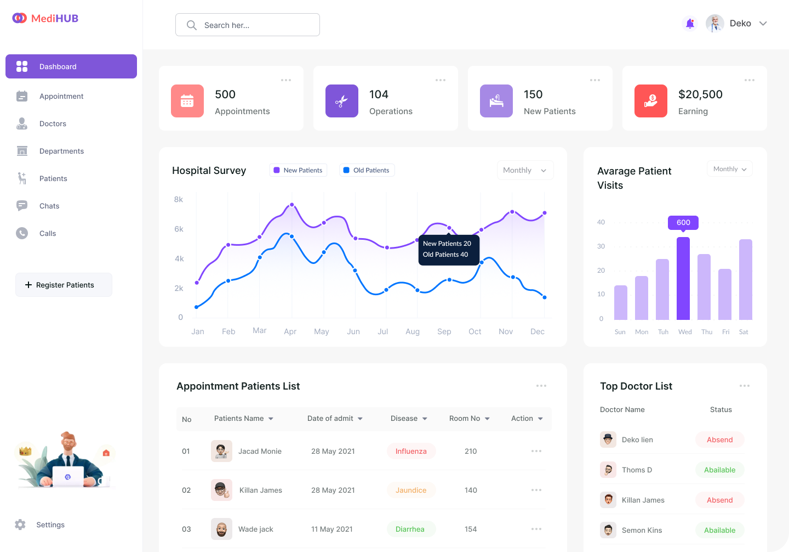

Slide 12






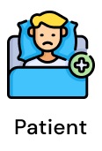
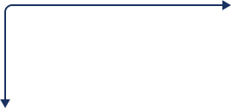



COLLABORATION & COORDINATION

Slide 13
CONCLUSIONS
In our country, well-known hospitals are using different software technologies, which can be quite expensive. However, it can be challenging for general hospitals or clinics to afford such system.
Our solution offers a common platform that provides a smart system that accessible to hospitals regardless of their size or budget constraints.
It offers a wide range of features and services, including online booking systems, patient monitoring, hospital management, pharmacy services, emergency services and more.
The platform has the potential to revolutionize the way healthcare services are delivered, improve patient outcomes, increase efficiency, improve access to healthcare services, and drive innovation in healthcare.

Slide 14
Thank You for your kind attention

